Slide 1



Bonsai On A Budget
Alex Labram
MMM YYYY
Nemeta Bonsai
nemeta.co.uk

Slide 2
Learning Outcomes
Good enough
Be aware of the history and culture of bonsai
Understand (at a high level) how a bonsai is produced
Understand (at a high level) what distinguishes good and bad bonsai
Know how to maintain a bonsai on a day-to-day basis
Experience the key activities of re-potting, pruning and wiring
Be aware of inexpensive options for further learning and practice

Slide 3
Bonsai: What & Why
Good enough
Defining bonsai
A bonsai is a living trompe-l’oeil: a small tree that appears to be a scaled-down large tree.
Almost any kind of tree can become a bonsai (plus a few things that aren’t trees!)
“Bonsai” traditionally referred to Japanese schools, but has become a generic term
Why ’Sai?
Hands-on education in plant science!
Learn to see extra layers of beauty in nature
Good practical hobby with interesting culture
Sense of control and responsibility
To see a World in a Grain of Sand
And a Heaven in a Wild Flower
Hold Infinity in the palm of your hand
And Eternity in an hour
- William Blake

Slide 4
Bonsai: A Potted History
Good enough
China
Daoist mysticism: recreation of magical sites in miniature
Penjing (盆景) / Penzei (盆栽) = the art of miniature landscapes (pre 600AD)
Popular amongst Buddhist monks, and – later – aristocracy
Heavily impacted by Mao’s Cultural Revolution: seen as a bourgeois pastime
Japan
First records c. 1200AD; known as Hachi-no-Ki (“potted trees” – also the name of a famous play!)
Heavy Zen / Chan Buddhist influence: beauty through austerity, sophistication in simplicity and perfection from imperfection (“wabi-sabi”)
Increasingly popular from 1800s onwards; term “bonsai” (盆栽 – “tray planting”) adopted
Development of distinct styles (dramatic archetypes)
Hit hard by World War 2, but revived in the aftermath (partly from enthusiasm of GIs)
Exported to West from 1960s onwards, in parallel with Japan’s “economic miracle”

Slide 5

Bonsai: Art & Science
Good enough
Good bonsai practice is:
Authentic - makes you think “tree”
Dramatic – makes you think “TREE”
Pragmatic – doesn’t make you think “dead tree”…

Slide 6
Pragmatism 1
How Not To Kill Your Tree

Slide 7
What Kind Of Tree Is A “Bonsai”, Anyway? (Trick question alert!)
Good enough
Tree: “a large, tall, woody, perennial plant with a single, unbranched, erect, self-supporting stem holding an elevated and distinct crown of branches with a total height greater than ten feet and a diameter greater than three inches” – oy vey!
Almost any tree species can be trained into a bonsai; many smaller plants can too
Requirements for bonsai-ing:
Vascular plant (no mosses!)
Woody growth / “lignification” (no daisies!)
Secondary growth of trunk (no palms!)
Free-standing (no lianas!)
Deep roots (no grasses!)
Desirable features
Attractive / interesting species
Small or pinnate leaves
Long-lived
Reasonably fast-growing
Easy to maintain / shape
“Honorary” bonsai species
Woody climbers: ivy, wisteria, honeysuckle
Succulent / fleshy: dwarf jade, geranium
Chrysanthemum

Slide 8
I Had One Once, But It Died What a bonsai needs to survive
Good enough
Environment
Indoor vs Outdoor
Watering!!!!!
Single biggest killer of bonsai
“Root hairs” die easily in drought
Over-watering is also dangerous!
Light
Heat
Dormancy
Airflow
Pest Control
Animals: spider mites, scale bugs, aphids, caterpillars, vine weevil, squirrels
Plants etc: pearlwort, liverwort, wood sorrel, pennywort, nostoc
Caution: environmental issues!
Fertiliser
“Balanced”: roughly even NPK
Organic => micronutrients
Caution: environmental & ethical issues!
Bonsai are far harder to keep alive than most common pot plants!

Slide 9
Watering Your Bonsai No, seriously, this is important
Good enough
Why so serious?
Trees usually have deep tap-roots to draw water; they don’t handle drying out well
…Especially conifers, for some reason
Good-quality bonsai soils / pots have really good drainage… so can dry off quickly
Bonsai soil is very compact and often moss-covered… so water tends to run off the surface
Traditional bonsai soil is inorganic, so lacks the “ladders” of plant fibre that let water rise up through the pot
Even gardening experts routinely kill their first bonsai!
Watering methods
Put in bucket of water (to just below brim) and wait for water to bubble up
…Then take out and allow to drain fully. Never leave standing in water for long periods – roots need oxygen too!
Water from above three times, allowing the water to sink in between passes
Is it watered enough?
Surface feels damp to back of hand
Pot significantly heavier
Water running out of hole in bottom when more is added

Slide 10
Authenticity & Drama
Thinking Like A Tree (That’s Seen Some S**t)

Slide 11
Arboriculture 101 What shapes a tree?
Good enough
Sunlight
Airflow
Gravity / load
Shade
Animals

Slide 12
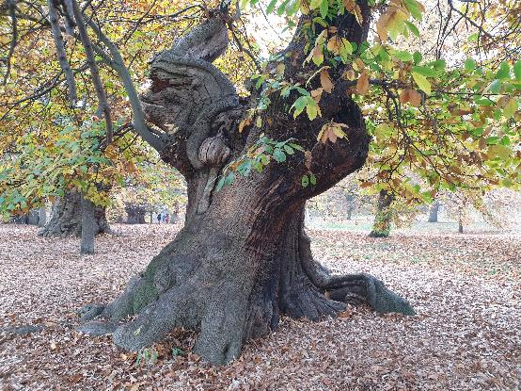
Authenticity & Age What makes a tree look mature?
Good enough
Canopy shape
Rounded triangle
Composed of rounded-triangle “pads” (for species that back-bud less readily)
Trunk & branch behaviour
Short inter-node distance
“Ramification”: fractal splitting of branches
“Square-cube law”: big tree = proportionally heavier load = more curvature
“Ruptures”: jagged direction changes
Texture
Bark
Dead-wood: advanced bonsai topic!
Taper
“Nebari” (根張り) = root flare
Trunk & branch flare: base to apex / tip
Trunk-to-branch ratio

Slide 13
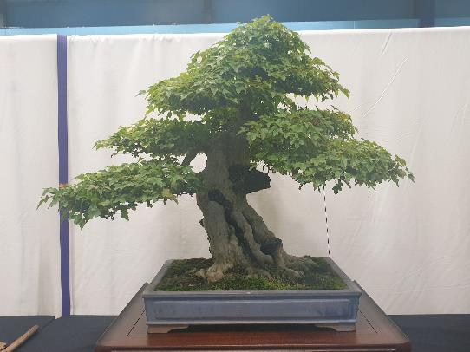
Drama & Perspective What makes a tree stand out?
Good enough
Taper (again!)
Taper appears stronger from viewpoint at base of tree
Pot: picture-frame for tree
“Heavy” earthenware vs “light” glazed
Depth ≈ trunk thickness; width ≈ 2/3 canopy height (tall tree) or width (wide tree)
Style: heavy vs light, plain vs ornate
Use of negative space
…Often justified as effect of wind-flow or trunk death
Scaled-down decorations
Moss “grass”, accent plants, rocks (“suiseki”)
Well-defined “front”
Style is firmly established
Sense of strength or movement captured
Clear view of lower trunk
No crossed branches
Tree’s “centre of mass” is in middle of pot

Slide 14
Flaws What gives the game away?
Add picture
Image
Obvious tool marks
…Including wire scarring
Excessive symmetry
…Especially handlebar branches
Asymmetry is a common theme in Japanese gardening!
“Reverse taper”
Unusual “habit” for species / genus
Google for pictures of wild tree to get ideas!
This rule is frequently ignored: e.g. small shrubs portrayed as large trees, boringly-shaped species made interesting, unrealistic pads
Clean of dead leaves and (unwanted) deadwood
“Weak” branches
Suckers
Congested nodes
Under-slung / elbow branches
Lack of clear “leader” (dominant trunk / branch)

Slide 15
Wabi-Sabi Japanophilia 101
Finish slide
Image
Obvious tool marks
…Including wire scarring
xxx
“Wabi” () – literally “forlorn”
“Sabi” () – literally “rustic”

Slide 16
Bonsai Styles The most common four of… thirty? Really?!?
Good enough
Formal Upright
Cascade
Strong, proud, “yang”
Pot: unglazed earthenware; simple shape; bulging
Can be hard to develop taper
Flowing, falling
Pot: deep to make space
“Half-cascade” runs to base of pot; “cascade” goes below that
Informal Upright
Literati
Relaxed, elegant, “yin”
Pot: glazed; fluting; flowery
Broad range of possible shapes
Basically the default style!
Solitary, melancholy, bleak
Trunk: bare, ruptured, calligraphic
Pot: small to emphasise plant’s extravagant loneliness
Style derived from woodcuts in classic Chinese drawing guide

Slide 17
Pragmatism 2
Making Life In Miniature

Slide 18
Bonsai Lifecycle
Add cartoons for each stage
Sources
Training
Refinement
Slow
Seeds
Cuttings
Fast
Garden centre seedlings
Scavenging
Ready
“Nonsai”
Garden centre mature trees
Yamadori
Display
Exhibition
Photography
On-boarding
Grow out
Re-pot
Prune
Wire
Cut back
Major intervention
Restyling
Air layering
Deadwood
Dead ☹

Slide 19
Repotting
Currently a quick summary Desperately needs diagrams
Regular repotting – often back into the same pot! - helps limit tree size via “root-to-shoot ratio”
1. Prepare pot
Pick a (tentative) pot
Scrub clean
Staple mesh over holes
Add guy wires
2. Prepare tree
Remove from pot
Clean off soil surface
Dig down to expose nebari
Dig up / in to define root-ball
Untangle lateral roots where poss. (esp. girdling roots)
Clear any growth from lower trunk
Spray with water if starting to dry!
3. Insert tree into pot
Add shallow layer of soil to base
Place root ball in pot and pack soil around
Compress soil to “brownie” hardness
Pull guy wires over root ball, twist pairs together tightly, and trim to 3-4 twists
Cover with dried, grated, rehydrated sphagnum and compress surface
Sprinkle with grated acrocarpous (upward-growing) moss

Slide 20
Pruning Broadleaf Trees Playing In Easy Mode
ACTIVELY MISLEADING
Allow to
grow out
Conditions
Can handle loss of mass
Back-buds readily
Leaves may be simple or compound
Leaves may be alternating or opposite
Philosophy
Minimal wasted growth
Each branch should have “two heirs and a spare” (at least)
The spare is a “sacrificial” branch: it can be removed later, once the chosen “heirs” are established, or allowed to grow out to thicken the parent branch
Repeat for each new branch
Pinch off tip
Wait for buds to burst
Wait for buds to burst
Cut back
to 3 nodes*
* Or 2 nodes (4 buds) for opposite leaves

Slide 21
Pruning Conifers Getting trickier
UNFINISHED
Needle-bearing / pine-like
Preconditions
Back-buds weakly from old growth
One or more needles per bundle
Philosophy
Green growth should form “pads”
Conditions

Slide 22
Wiring H2
UNFINISHED

Slide 23
Thanks For Attending!

Slide 24
H1 H2

Slide 25
Appendices
Miscellaneous Technical Notes

Slide 26
Woody Plants: A Family Tree Evolution From A Bonsai Pruner’s Perspective
Prune as:
Broadleaf
Needley conifer
Spiky / scaly conifer
Special case
Good enough
B
N
S
!
Vascular plants
B
Gymnosperms (“Naked Seed”)
Angiosperms (“Covered Seed”)
Magnoliids
!
Gingko
B
B
Pinaceae (“Pine-like conifers”)
Cupressaceae (“Cypress-like conifers”)
Asterids
Rosids
N
Pine
B
Yew
“True” Cypress
S
Ash
(Crab) Apple
Oak
N
B
S
Spruce
Redwood
Juniper
Elder
Elm
Maple
N
S
S
“True” Cedar
Sugi
“False” Cedar
Rhododendron
Prunus: Cherry, Plum, Apricot, etc
Lime
N
Beech
Larch
Azalea

Slide 27
Wiring a Bonsai Pot What could go wrong?
Good enough
Mesh & Staple
(Plastic mesh, 2mm alum. wire)
Guy wires
(1.5mm alum. wire x 2)
wire above mesh
wire below mesh & pot
wire below mesh
wire above mesh & along sides of pot
one side of each wire longer than the other
view from short side
view from long side
extra bend makes it obvious which is the longer side
guy wire will be held in place by staple

Slide 28
How Often To Water Some key factors
Good enough
Pot
Depth: deep → less frequent
Shape: bulbous → less, fluting → more
Inner surface: glazed → more
Soil
Drainage: well-draining → more
Degradation: older → harder to water
Covering(s): dead sphagnum and/or live moss → harder to water but slightly less (in theory)
Tree
Maturity: older → less (in theory)
Fertilisation: heavy → more
Re-potting: recent → more
Environment
Wind: windier → more
Sun: sunny → more, shady → less
Heat: hotter → more, colder → less
Season: Winter = least, Summer = most
Warning: these factors are “non-linear”! A small increase in e.g. sun can mean a big increase in watering.
…Mostly it’s not worth the effort to figure out the “right” watering frequency. Just keep checking the pot every day!

